Slide 1
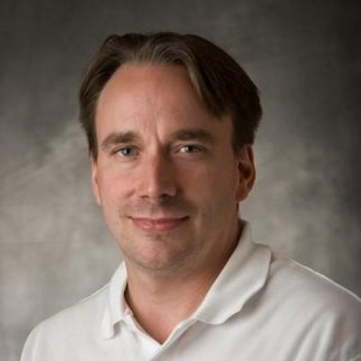
Linus Torvalds
Born: 28 December 1969 - Helsinki, Finland
Nationality: Finish and American (naturalized in 2010)
Master degree: Computer science (1988 - 1996)
Occupation: Software engineer

Slide 2

Linux kernel is used on Linux, Android and Chrome OS.
No open source (UNIX) or freedom alternatives (MINIX).
Inspired by Richard Stallman’s incomplete kernel (GNU).
Ari Lemmke said that Freax (Free + Freak + x) was not a good name.
Linux kernel first release in September 1991.

Slide 3

1991 - 2002: Changes were passed around as patches and archived files.
2002 - 2005: BitKeeper (but in 2005 it was no longer free).
>2005: Git (Distributed revision control system) started in April 2005.
Since July 2005 Junio Hamano has been the maintainer of Git.

Slide 4
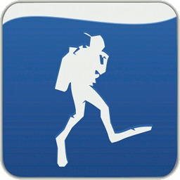
Subsurface is a software for logging and planning scuba dives.
First version released in September 2011.
Latest stable version released in November 2020.
Free and open-source software.
So, why Linus developed Subsurface?

Slide 5
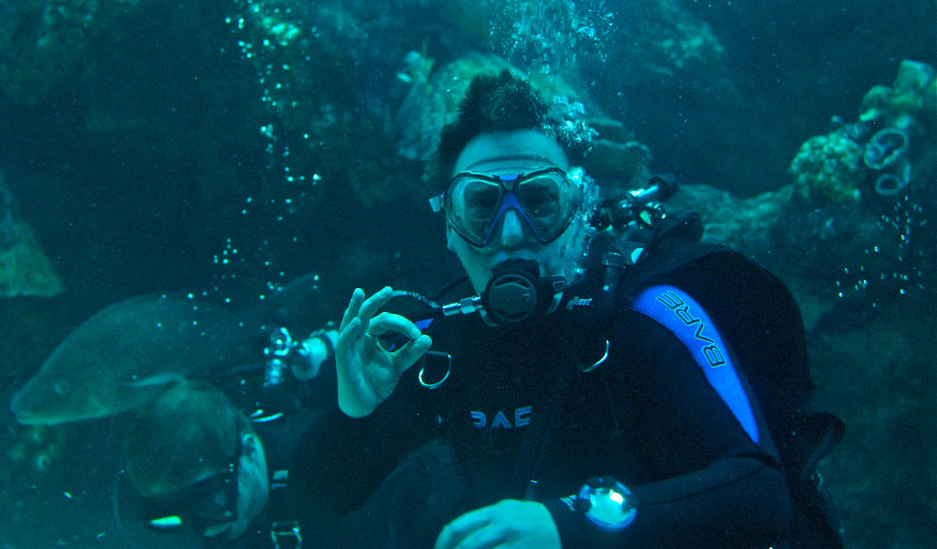

Slide 6

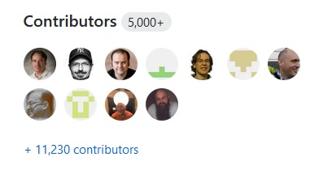
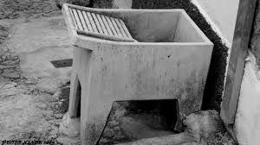

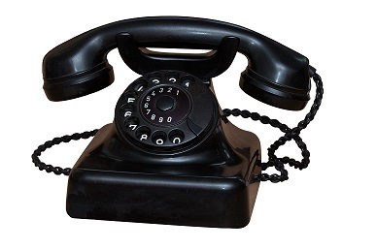
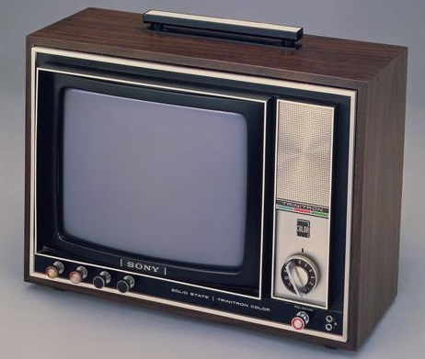
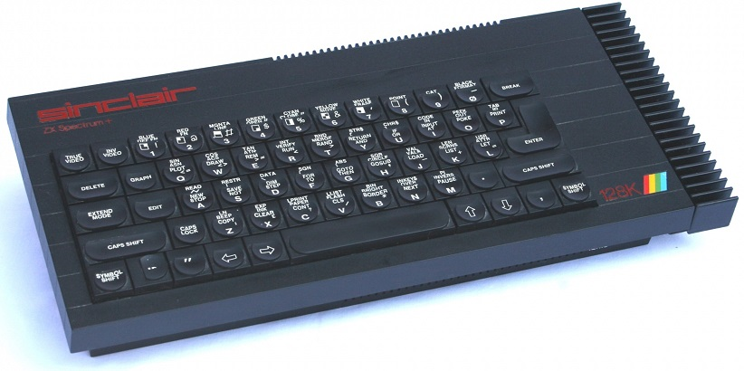

Slide 7

Linux kernel as an average of 100 commits per day.
Linus Torvalds is extremely introvert :)
Linus started to be the only one to validate pull requests.
But currently there are more than 1500 kernel maintainers.
97% of the Linux kernel code is written in C.

Slide 8

Awards and achievements
1995 - Running Linux on AlphaStation
2008 - Hall of Fellows
1996 - 9793 Torvalds (Asteroid)
2010 - C&C Prize
1997 - Academic Honors
2012 - Millennium Technology Prize
1998 - EFF Pioneer Award
2012 - Internet Hall of Fame
2000 - Lovelace Medal
2014 - IEEE Computer Pioneer Award
2001 - Takeda Award
2018 - IEEE Masaru Ibuka Consumer Electronics Award
2003 - Linus (Moon)
2005 - Vollum Award

Slide 9
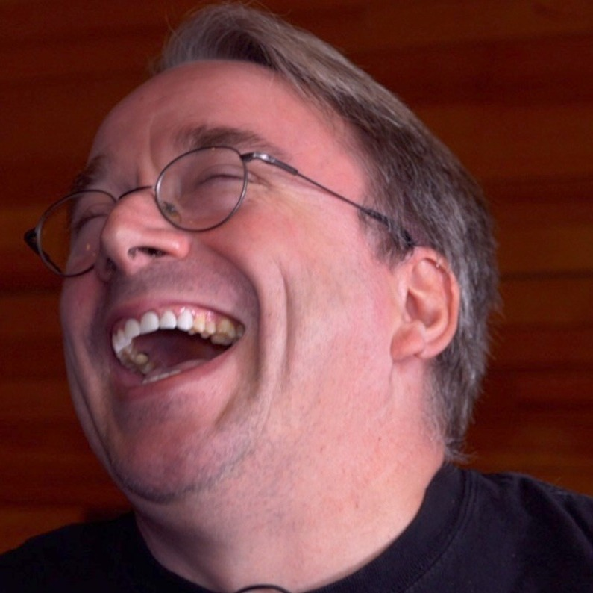
Microsoft isn't evil, they just make really crappy operating systems.
Software is like sex: it's better when it's free.
A computer is like air conditioning – it becomes useless when you open Windows.

Slide 10
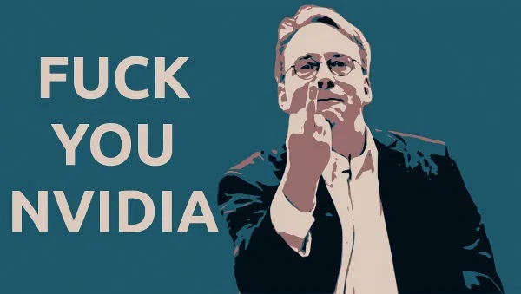

Slide 11
Thank you

